Slide 1
Lipid Transport

Slide 2
Quiz Question #1
What dietary factor is most associated with increased LDL cholesterol?
Saturated fatty acids
Monunsaturated fatty acids
Polyunsaturated fatty acids
Fiber

Slide 3
Quiz Question #2
What does reverse cholesterol transport refer to?
Transport of cholesterol from the gut lumen to the liver
Transport of cholesterol from the liver to the periphery
Transport of cholesterol from the periphery to the liver
Transport of cholesterol within cells to nascent VLDL particles

Slide 4
Quiz Question #3
What is the main role of lipoprotein lipase
Release of lipids from adipose tissue to the blood
Release of lipids from the gut to the bloid
Release of lipids to enter adipocytes/muscle
Release of lipids to enter the liver from the blood

Slide 5
Learning Objectives
Explain why lipoproteins are necessary for triglyceride and cholesterol transport.
Describe the main carriers of cholesterol and triglyceride throughout the body, including how their apolipoproteins affect their endocytosis or catabolism.
Apply your knowledge of cholesterol transport to explain why someone may have changes in HDL and LDL levels.
Understand the etiology of high cholesterol and its potential role in atherosclerosis.
Apply your understanding of cholesterol absorption, synthesis and transport to evaluate the relationships between dietary cholesterol and triglycerides and cardiovascular risk.
Explain the role of lipoprotein lipase in lipid transport, including how it is regulated.

Slide 6
Triglycerides from Chylomycrons and VLDL

Slide 7
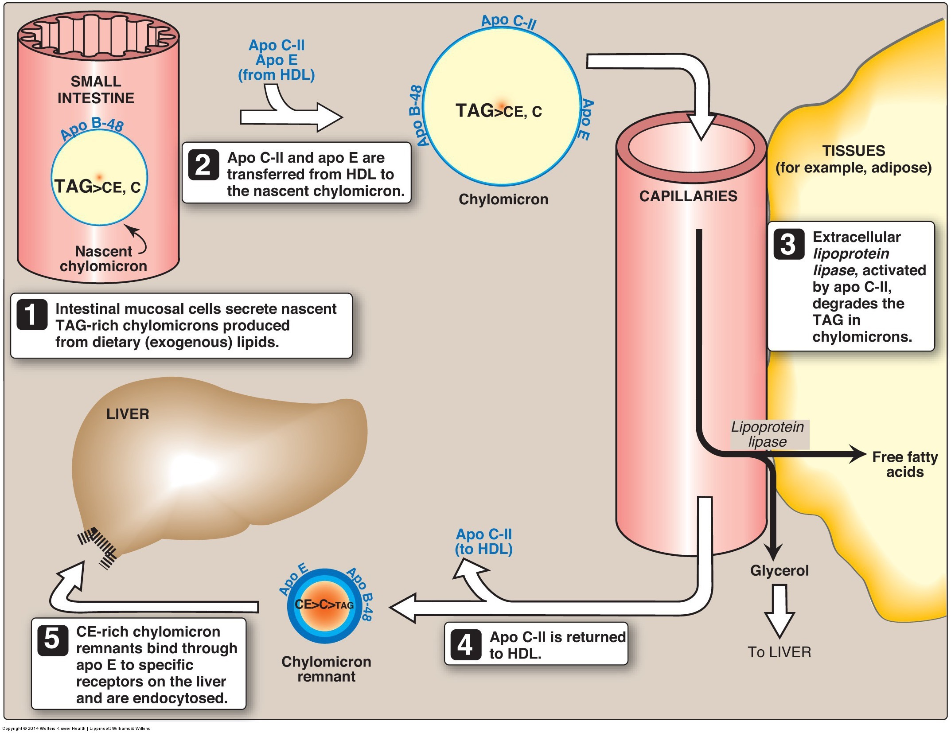
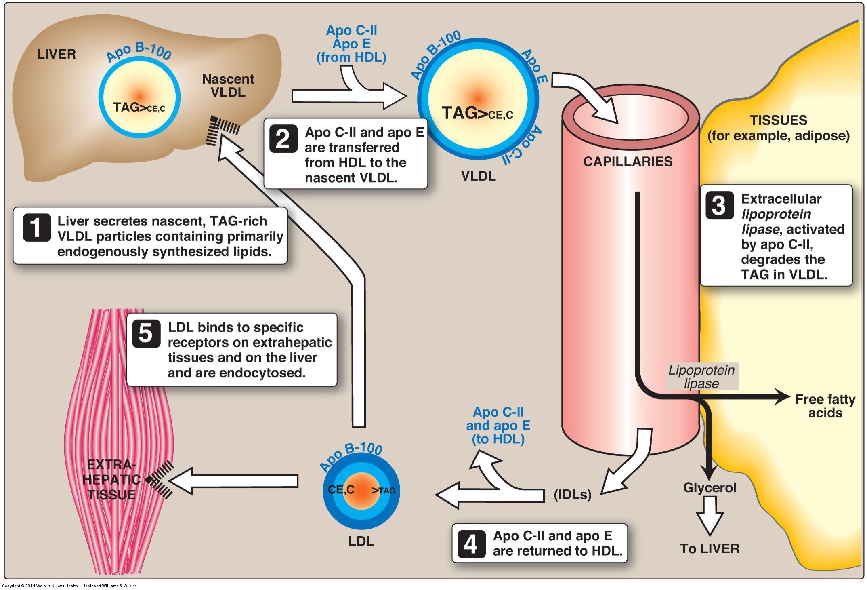
Lipid Transport from Liver
Mainly synthesized in liver and adipose tissue
Small amount from de novo lipogenesis
Primarily fatty acids from dietary fat
In the liver triglycerides and cholesterol are synthesized, then packaged for transport to adipose tissue via VLDL

Slide 8
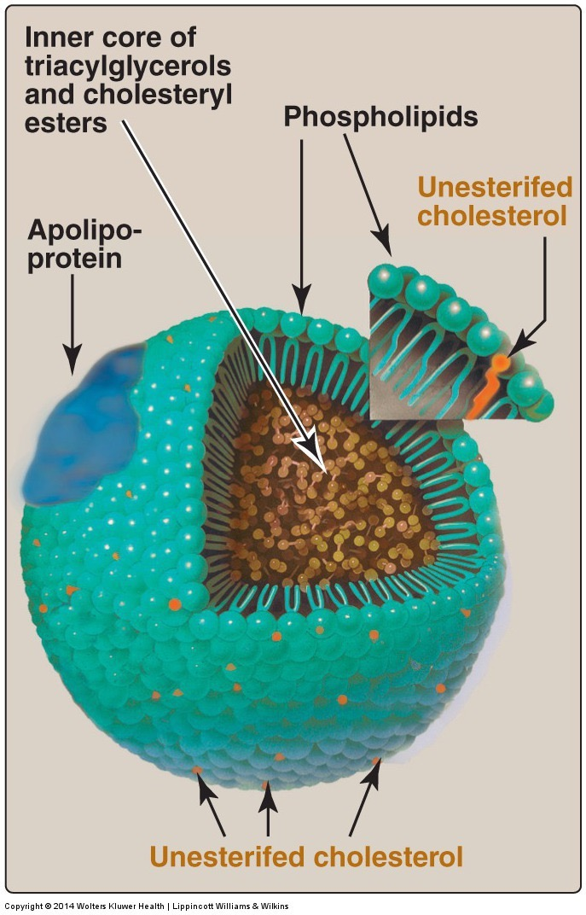
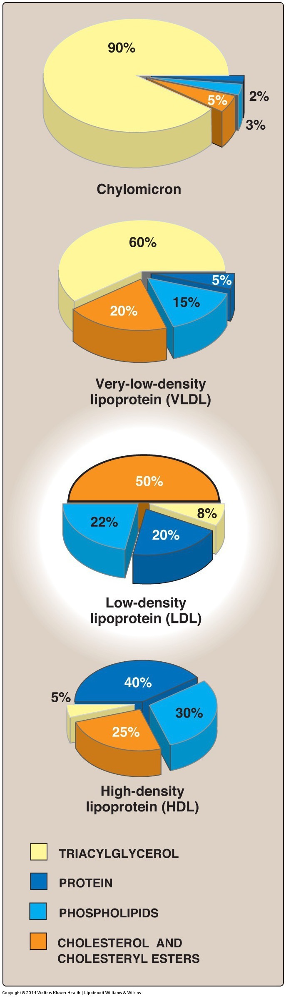
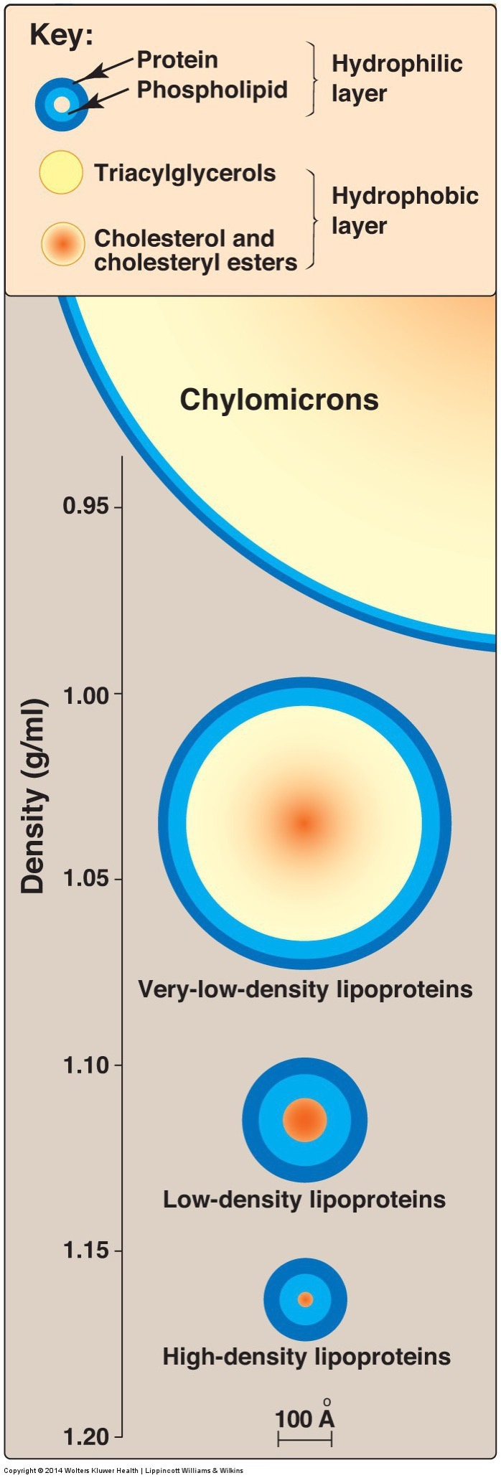
Lipoprotein Particles and Composition

Slide 9
Lipoprotein Particle Summary
Class | Composition | Apolipoproteins
Chylomicron | Mainly TG | A-V, B-48, C-II, C-III, E
Chylomicron Remnant (CR) | Mainly Cholesterol | B-48, E
VLDL | Mainly TG | A-V, B-100, C-II, E
IDL | TG/Cholesterol | B-100, E
LDL | Cholesterol | B-100
HDL | Empty | A-I, A-II, E
Receptor | Particle | Ligand | Tissues
LDLR | LDL, CR (poor) | B-100/48, E | Liver
SR-BI | HDL | B-100 | Liver
LPL | Chylomicron/VLDL | CII | Peripheral
ApoA1 activates LCAT
CII activates Lipoprotein Lipase
CIII inhibits Hepatic Lipase and Lipoprotein Lipase
Notes:
CII lost as triglycerides are depleted
Note that there is an error on this slide

Slide 10
What do the following measures mean?
Total cholesterol
LDL-cholesterol
HDL-cholesterol
ApoB100 concentration
ApoB100/ApoA1 ratio
Triglyceride/HDL ratio
Think about differences in number of particles versus the composition of particles

Slide 11
Production of VLDL by the Liver

Slide 12
Fatty Acids are Liberated from TG by Lipoprotein Lipase in Most Tissues
LPL highly expressed in heart, muscle, fat
Secreted by cells to ECM
Activated by Apolipoprotein on Chylomicron/VLDL
ApoCII activates
ApoCIII reduces

Slide 13
Control of LPL Activity
Insulin
Activates in Fat
Inactivates in Muscle
Fasting/Cortisol
Inactivates in Fat
Activates in Muscle
Intracellular lipids
Suppress via PPARa/ANGPTL4

Slide 14
Mutations in LPL System
LoF causes Less CVD
LoF causes More CVD
https://twitter.com/skathire/status/839151207436419072

Slide 15
Cholesterol Synthesis and Transport

Slide 16
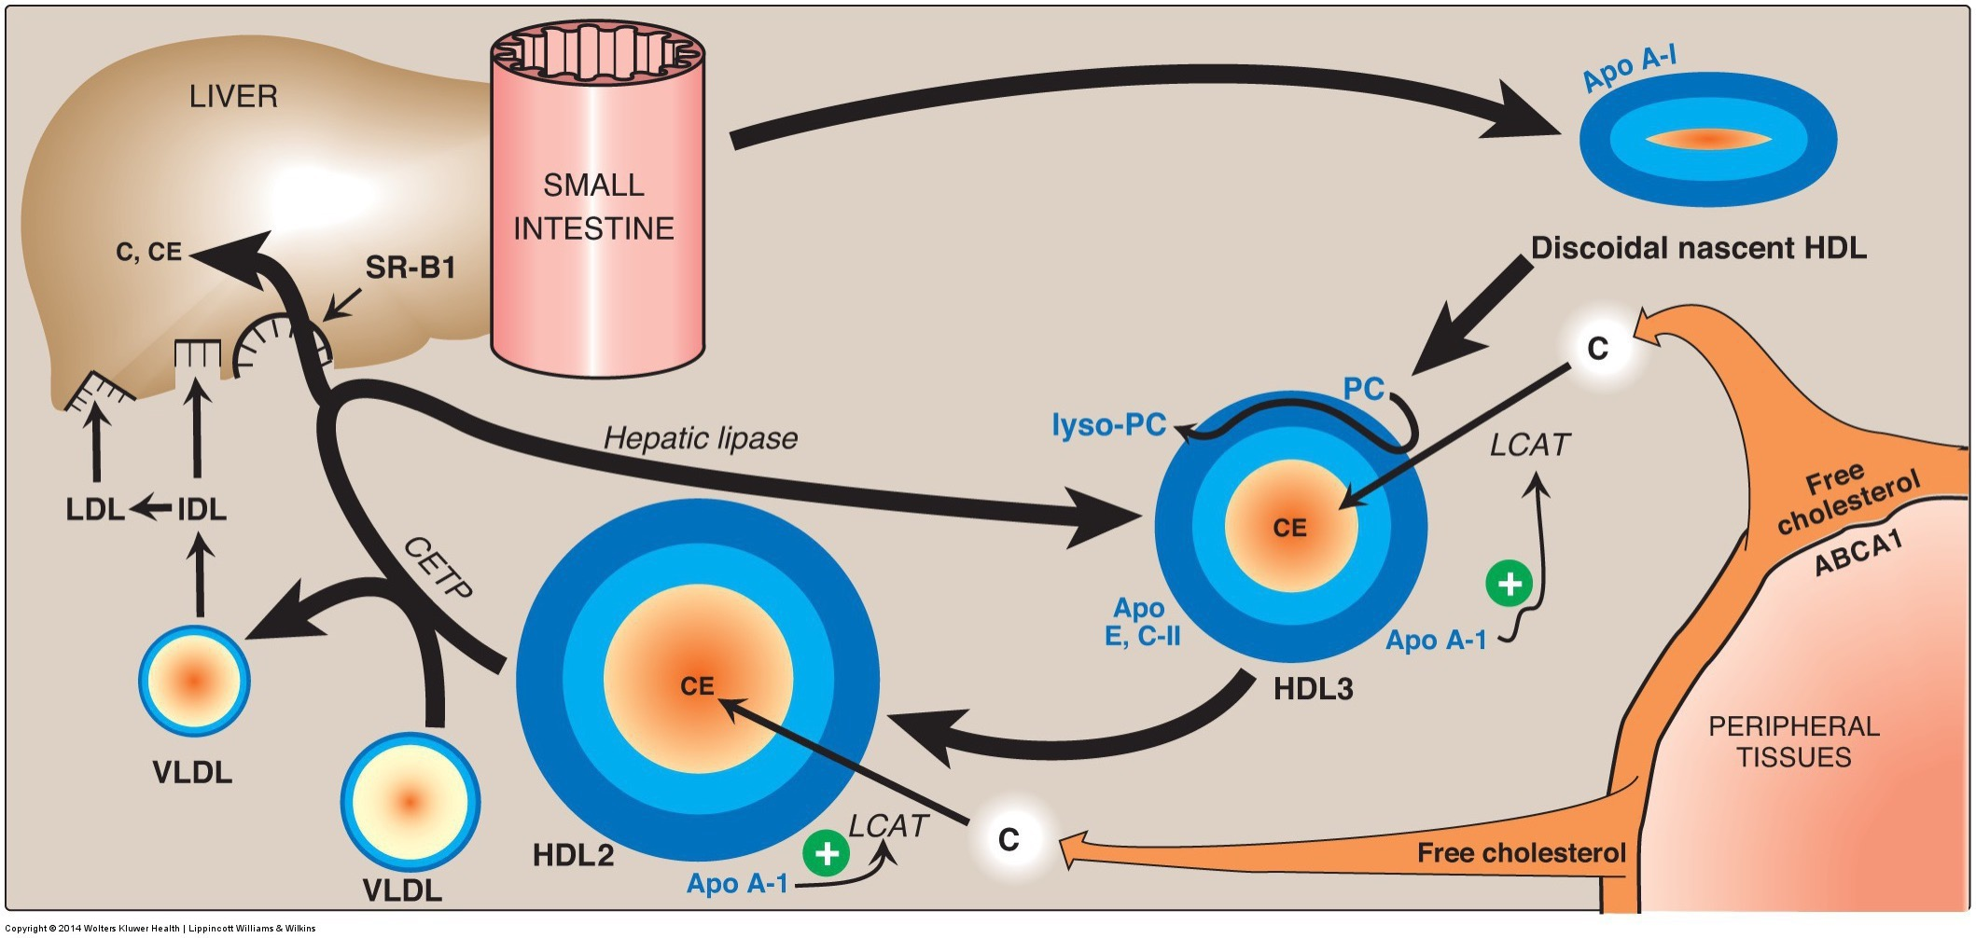
Retrieval of Cholesterol from Tissues
HDL soaks up cholesterol from other tissues
Taken up by liver via SR-B1 (poor efficiency)
HDL can also transfer lipids to LDL via CETP

Slide 17
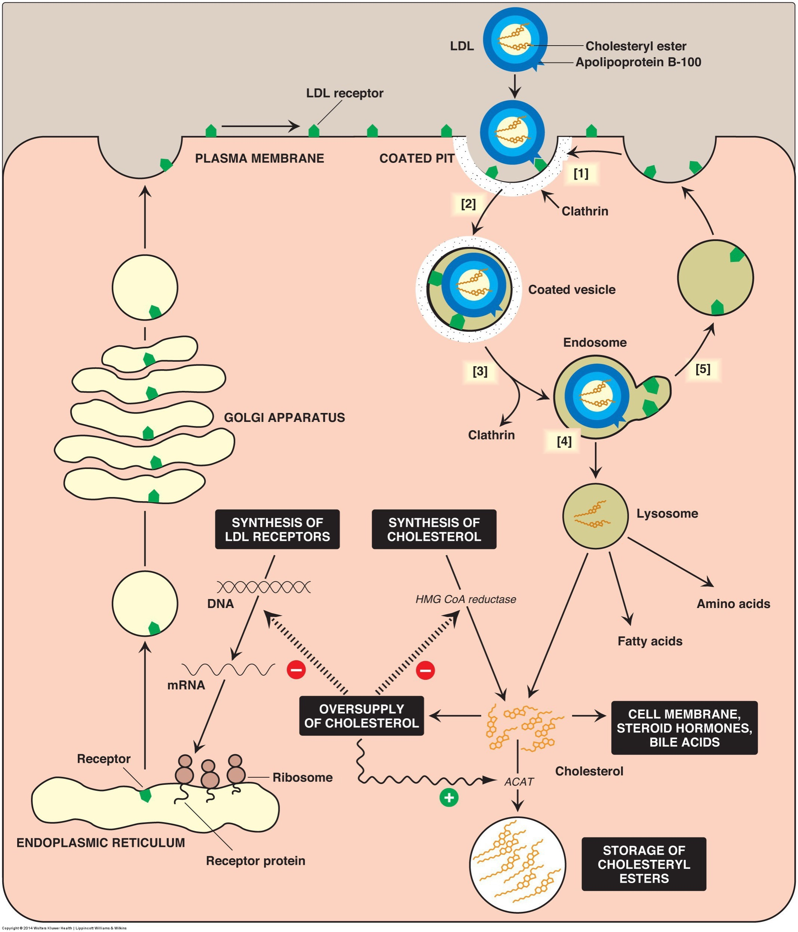
Regulation of LDL Uptake in the Liver
LDL from
Depleted VLDL
Transfer from cholesterol rich HDL
High hepatocyte cholesterol
Inactivation of SREBP2
Less LDL Receptors
Less HMGCR

Slide 18
Thought Experiment
If you had a mutation of LDLR
What would happen to LDL levels in the blood?
What would happen to inter-hepatocyte cholesterol levels?
What would happen to SREBP2 activity?
How would that affect cholesterol synthesis?
Would that alleviate or exacerbate hypercholesterolemia?

Slide 19
LDLR Mutations
Physiological outcomes:
Altered synthesis of LDLRs results in abnormal levels and functioning of receptors at cell membrane
Accelerated biosynthesis of cholesterol – HMG CoA reductase remains activated
Results in high LDL levels in blood
Diet can be contributing factor to high serum LDL
Controlled by drugs, dietary restrictions, exercise
Statins - class of drugs inhibiting HMG CoA reductase

Slide 20
LDLR Mutations
Cells unable to bind LDL via LDLRs (mutant cells)
Mutant cells – defect of chromosome 19
110 mutations effecting differing domains of LDLR
Broad term called Familial Hypercholesterolemia
1 in 500 carry at least one mutation
Emily C. O’Brien, PhD, et al. Rationale and design of the familial hypercholesterolemia foundation CAscade SCreening for Awareness and DEtection of Familial Hypercholesterolemia registry. American Heart Journal. 167:3. March 2014

Slide 21
Cholesterol and Cardiovascular Risk
Seven Nations Study – Ancel Keys
Cholesterol rises in proportion to saturated fat
Coronary events rose in proportion to serum cholesterol
13 fold higher in Finnish Foresters (270 mg/dL) than Japanese Fisherman (165 mg/dL)
Further studies linked cardiac risk to high LDL-C and low HDL-C

Slide 22
LDL Differences and Cardiovascular Events

Slide 23
NHS/HPFS Results
Wang, D. D. et al. Association of Specific Dietary Fats With Total and Cause-Specific Mortality. JAMA Intern. Med. 176, 1134–45 (2016).

Slide 24
But…. The PURE Study Results
Mente, A. et al. Association of dietary nutrients with blood lipids and blood pressure in 18 countries: a cross-sectional analysis from the PURE study. Lancet Diabetes Endocrinol. 5, 774–787 (2017).

Slide 25
Previous Studies vs PURE
 | Framingham/MCHS/NHS/HPFS | PURE
Participants | Americans (Mass or Minn) | Global, 18 countries
SES/Lifestyle Variability | Low | High
Ease of Adjusting for | Easier | Harder
Effect of SF on LDL | Increase | Increase
Effects of SF on CVD | Increase | Decrease
Big questions that are raised
Does LDL always associate with CVD risk?
Are there biological ethnic differences that we had missed?
Does PURE sufficiently account for lifestyle factors

Slide 26
Biophysical properties of LDL particles

Slide 27
What is the most predictive measure of LDL
MESA Study
Framingham Heart Study

Slide 28
LDL Particle Number and Size
How could you determine particle number?
Based on MESA, are smaller or bigger particles preferable
What might make a particle big and fluffy vs small and compact

Slide 29
This is the last lipids lecture!
Reflect on something you learned the lipid and, and write on a cue card how you could apply this information as advice in a nutrition related context.

Slide 30
Learning Objectives
Explain why lipoproteins are necessary for triglyceride and cholesterol transport.
Describe the main carriers of cholesterol and triglyceride throughout the body, including how their apolipoproteins affect their endocytosis or catabolism.
Apply your knowledge of cholesterol transport to explain why someone may have changes in HDL and LDL levels.
Understand the etiology of high cholesterol and its potential role in atherosclerosis.
Apply your understanding of cholesterol absorption, synthesis and transport to evaluate the relationships between dietary cholesterol and triglycerides and cardiovascular risk.
Explain the role of lipoprotein lipase in lipid transport, including how it is regulated.

